Slide 1
Unsupervised Clustering Algorithms
Grouping data without labeled outputs
Used for pattern discovery and segmentation

Slide 2
What is Clustering?
Unsupervised learning technique
Groups similar data points
No target variable

Slide 3
Clustering can be considered the most important unsupervised learning technique; it deals with finding a structure in a collection of unlabeled data.
• Clustering is “ the process of organizing objects into groups whose members are similar in some way”. i.e. the process of grouping a set of objects into classes of similar objects.
The commonest form of subsets of data set
• A cluster is therefore a collection of objects which are “similar” between them (i.e. similarity in the cluster) and are “dissimilar” to the objects belonging to other clusters.
• Cluster: A collection of data objects
➢ similar (or related) to one another within the same group
➢ dissimilar (or unrelated) to the objects in other groups

Slide 4
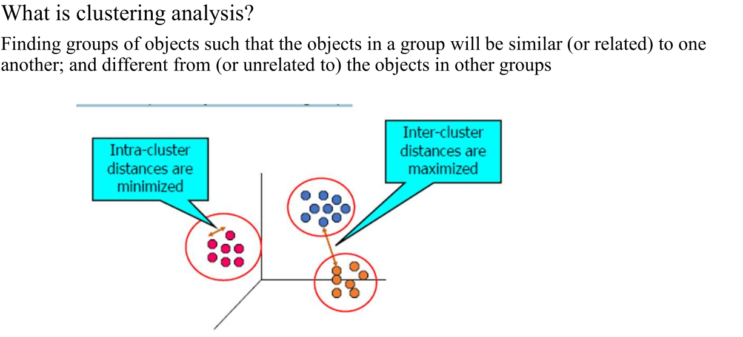

Slide 5
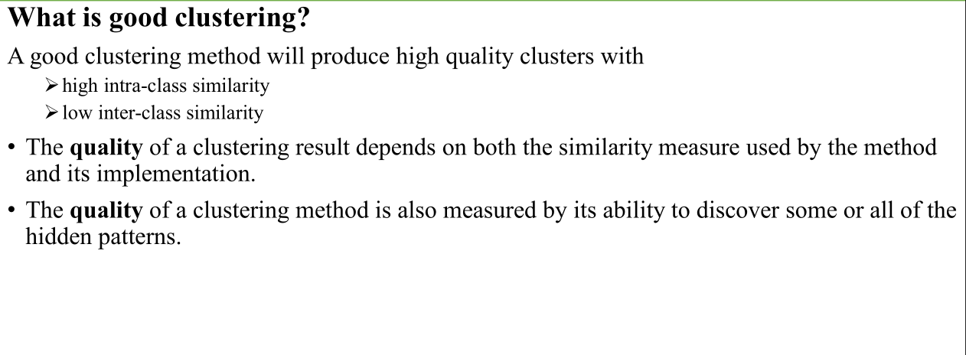

Slide 6
Major Clustering Approaches
Partitioning algorithms: Construct various partitions and then evaluate them by some criterion
Hierarchical algorithms: Create a hierarchical decomposition of the set of data (or objects) using some criterion
Density-based: based on connectivity and density functions
Grid-based: based on a multiple-level granularity structure
Model-based: A model is hypothesized for each of the clusters and the idea is to find the best fit of that model to each other

Slide 7
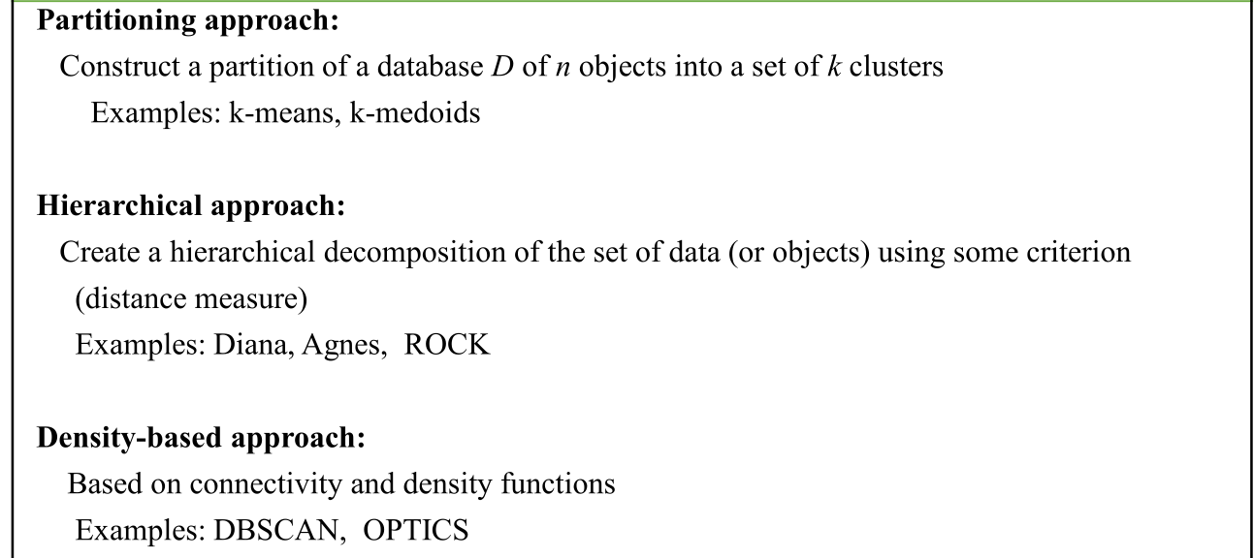
Clustering Techniques

Slide 8
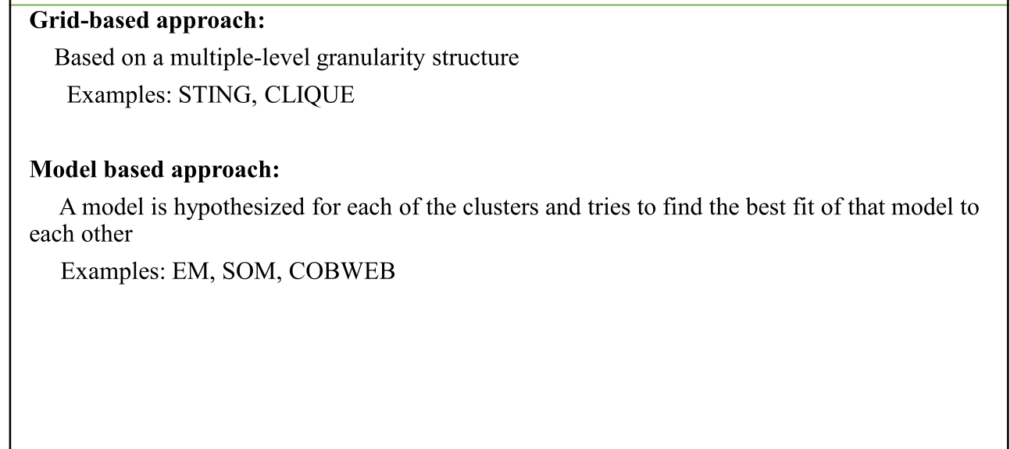

Slide 9
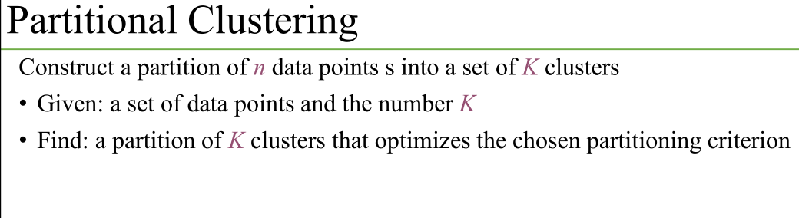

Slide 10
Heuristic methods: k-means and k-medoids algorithms
k-means: Each cluster is represented by the center of the cluster
k-medoids or PAM (Partition around medoids): Each cluster is represented by one of the objects in the cluster

Slide 11
K-Means Clustering
Partition-based algorithm
Uses centroids
Minimizes within-cluster variance
Requires K

Slide 12
Applications of K-Means
Customer segmentation
Image compression
Document clustering

Slide 13
Hierarchical Clustering
Agglomerative (bottom-up)
Divisive (top-down)
Dendrogram representation

Slide 14
Applications of Hierarchical Clustering
Gene expression analysis
Text mining
Biological taxonomy

Slide 15
DBSCAN
Density-based clustering
Finds arbitrary-shaped clusters
Detects noise/outliers

Slide 16
Applications of DBSCAN
Anomaly detection
Geographic data analysis
Image segmentation

Slide 17
Gaussian Mixture Model (GMM)
Model-based clustering
Uses probability distributions
Soft clustering

Slide 18
Applications of GMM
Speech recognition
Financial modeling
Image processing

Slide 19
Fuzzy C-Means
Data points belong to multiple clusters
Membership values

Slide 20
Applications of Fuzzy Clustering
Medical image analysis
Pattern recognition

Slide 21
Advantages of Clustering
No labeled data required
Finds hidden patterns
Useful in exploration

Slide 22
Limitations of Clustering
Choosing correct algorithm & parameters
Sensitive to noise
Interpretation can be subjective

